Slide 1
HTB sherlocks - Meerkat
Write up by Chanan Shenker

Slide 2
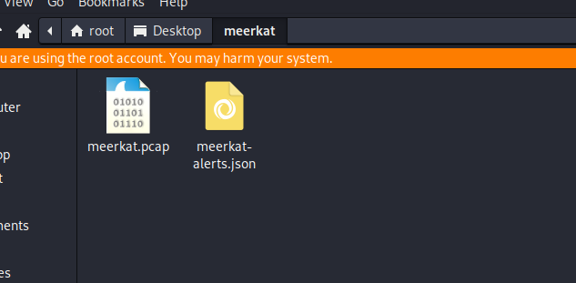
Start:
I started the challenge and got two file. A network recording and a Jason file.

Slide 3
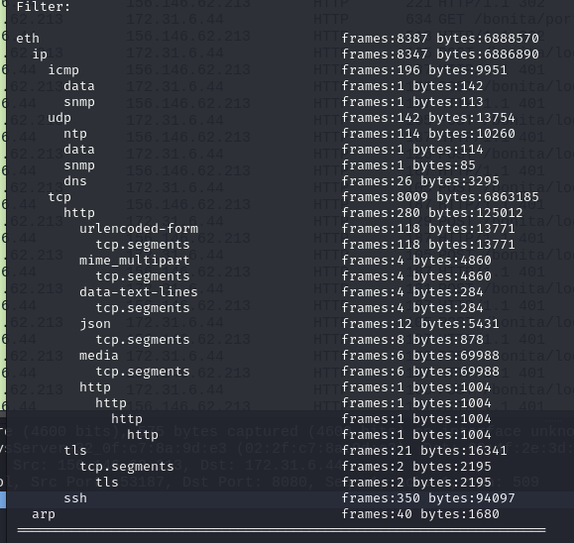
Question 1:We believe our Business Management Platform server has been compromised. Please can you confirm the name of the application running?
At first I went to look at the protocol hiercy to see if theres any unusual protocols that could indicate to me a certain application running.
I couldn’t see anything to interesting or unusual so I went to the next option and decided to look at the http traffic since its clear text and could be connected to a service or application.

Slide 4
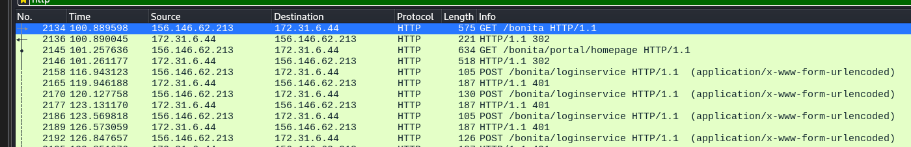
Lo and behold I see a home page and login service for ‘bonita’. A quick google search and I found
Its related to a business management service called ‘bonitasoft’
Answer 1: bonitasoft
Question 2: We believe the attacker may have used a subset of the brute forcing attack category - what is the name of the attack carried out?
I saw that the http traffic showed the login service page again and again with the reply being an http status code of 401, which tell us that the request lacks the valid authentication credentials to access the page. A quick search about subsets of brute force attack led me to find credentials stuffing, which is a attack that uses previously found credentials from data breaches or leaked data bases and attempt to login with them.
Answer 2: credentials stuffing.

Slide 5
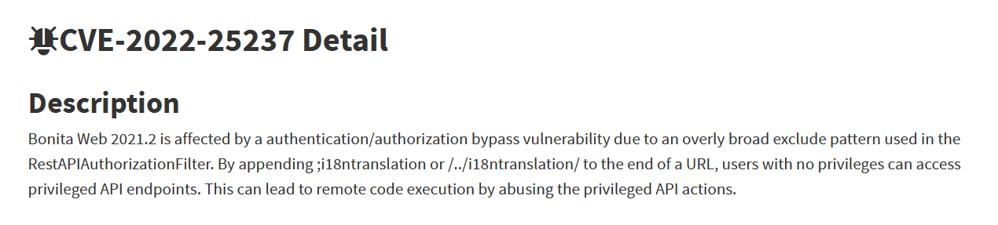
Question 3: Does the vulnerability exploited have a CVE assigned - and if so, which one?
I looked up bonitasoft and credentials stuffing and found a page by ‘National Vulnerability Database’ that assigned CVE-2022-25237 to this vulnerability.
Answer 3: CVE-2022-25237
Qusetion 4: Which string was appended to the API URL path to bypass the authorization filter by the attacker's exploit?
Looking at the description I found before it talks about appending the string ‘;i18ntranslation’ or ‘/../i18ntranslation/’, so went to look if I can find it in the network recording.
;;

Slide 6
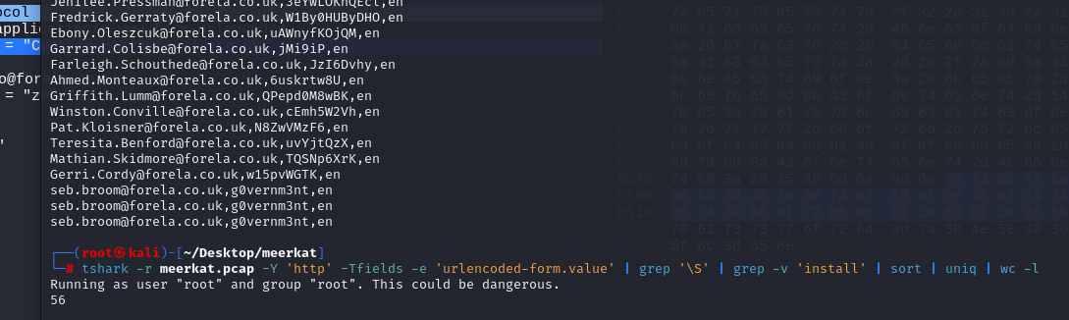
And there I found it the string I found in the description of the cve.
Answer 4: i18ntranslation
Question 5: How many combinations of usernames and passwords were used in the credential stuffing attack?
for this I looked at the request being set each time to the login service and found the field in the header that send the username and password, with the help of Tshark and some text manipulation I found the number of credentials that were used.
Answer 5: 56

Slide 7
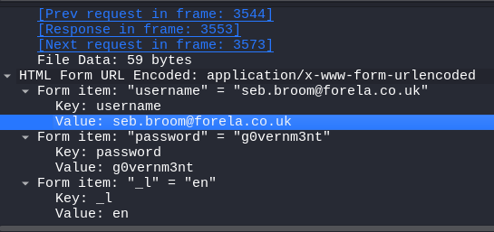
Question 6: Which username and password combination was successful?
I looked at all the failed attempt and saw that after one of the requests the http status code changed to 204, which indicates a successful request.
So i looked at the request right before the mentioned reply and opened up the fields in the request.
Answer 6: seb.broom@forela.co.uk:g0vernm3nt

Slide 8
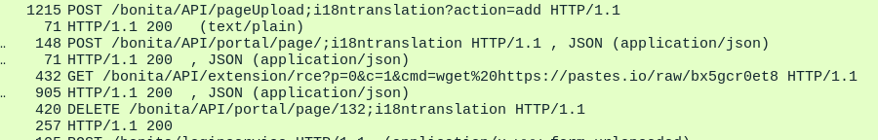
Question 7: If any, which text sharing site did the attacker utilise?
I continued to look at the network traffic and came a cross a packet that had appended to the url a wegt request from a site called pastes.io
I looked it up and yes it a script/text sharing site.
Answer 7: pastes.io
Question 8: Please provide the filename of the public key used by the attacker to gain persistence on our host.
At first I thought the file name would be the name of the file that was requested in the wget file but I was incorrect so I decide to get the file on my machine and see if theres anything else in the file.

Slide 9
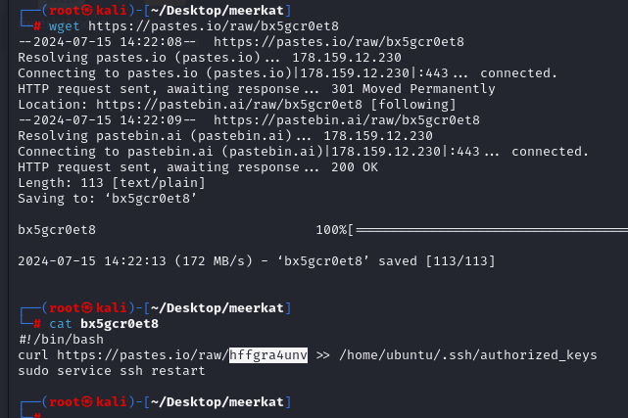
And there it is. I got the file, opened it and there was a second wget request for another file.
Answer 8: hffgra4unv

Slide 10
Qusetion 9: Can you confirmed the file modified by the attacker to gain persistence?
If we look at the file from the previous question we can see that the file was downloaded to /home/ubuntu/.ssh/authotized_keys file location.
Answer 9: /home/ubuntu/.ssh/authotized_keys
Question 10: Can you confirm the MITRE technique ID of this type of persistence mechanism?
I looked up MITRE attacks that have to do with persistence and ssh keys and found a page by MITRE ATT&CK that gave me the ID T1098.004
Answer 10: T1098.004

Slide 11
